Slide 1
Data Analytics (CMP330)
Dr. David Glass
School of Computing
dh.glass@ulster.ac.uk
Week 1 – Introduction to R
ulster.ac.uk

Slide 2
Introduction to R
What is R and Its History?
Statistical programming language for doing statistical analysis
Derived from the S language
Developed by John Chambers at Bell Labs
S won the Association for Computing Machinery’s Software System Award
In 2004 Insightful purchased the S language from Lucent for $2 million
In 2008 Insightful is acquired by TIBCO for $25 million

Slide 3
Introduction to R
More History
1991: R was Created in New Zealand by Ross Ihaka and Robert Gentleman. R was documented in a 1996 JCGS paper.
1993: First announcement of R to the public.
1997: The R Core Group is formed
2000: R version 1.0.0 is released.

Slide 4
Introduction to R
R is Free
Run the program
Redistribute copies
Access to the source code
http://www.fsf.org

Slide 5
Introduction to R
Drawbacks of R
40 year old technology
Lack of 3-D graphics
Objects stored in RAM
Can be slow! 100 times slower than C

Slide 6
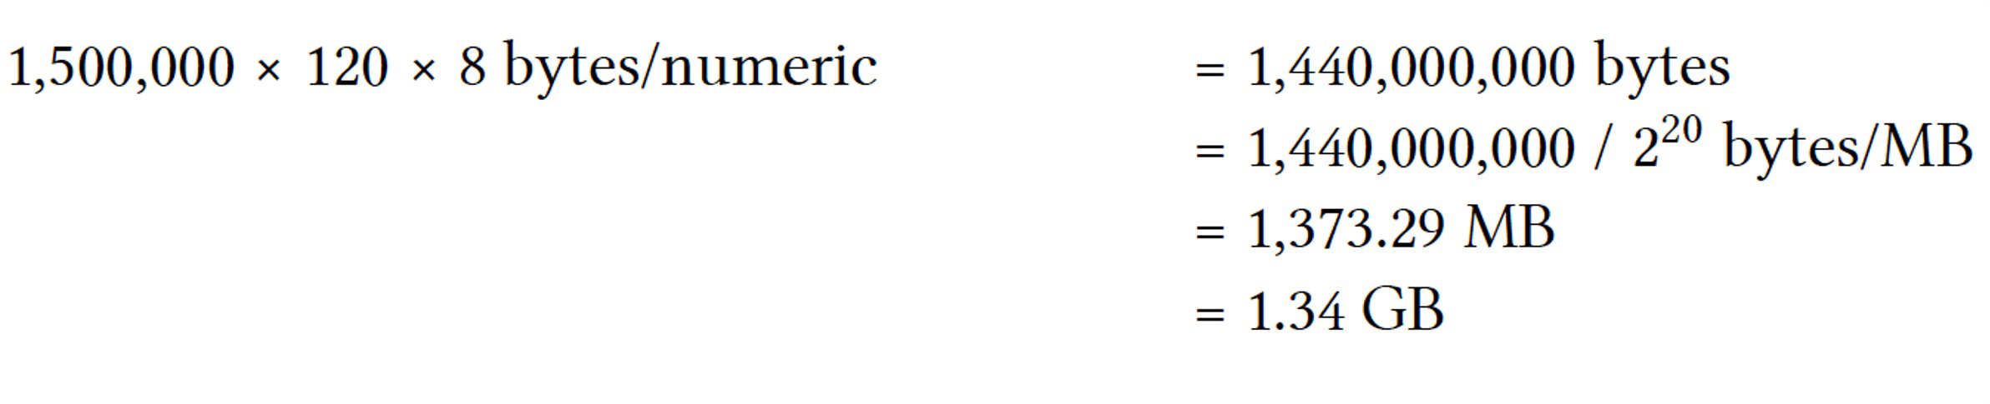
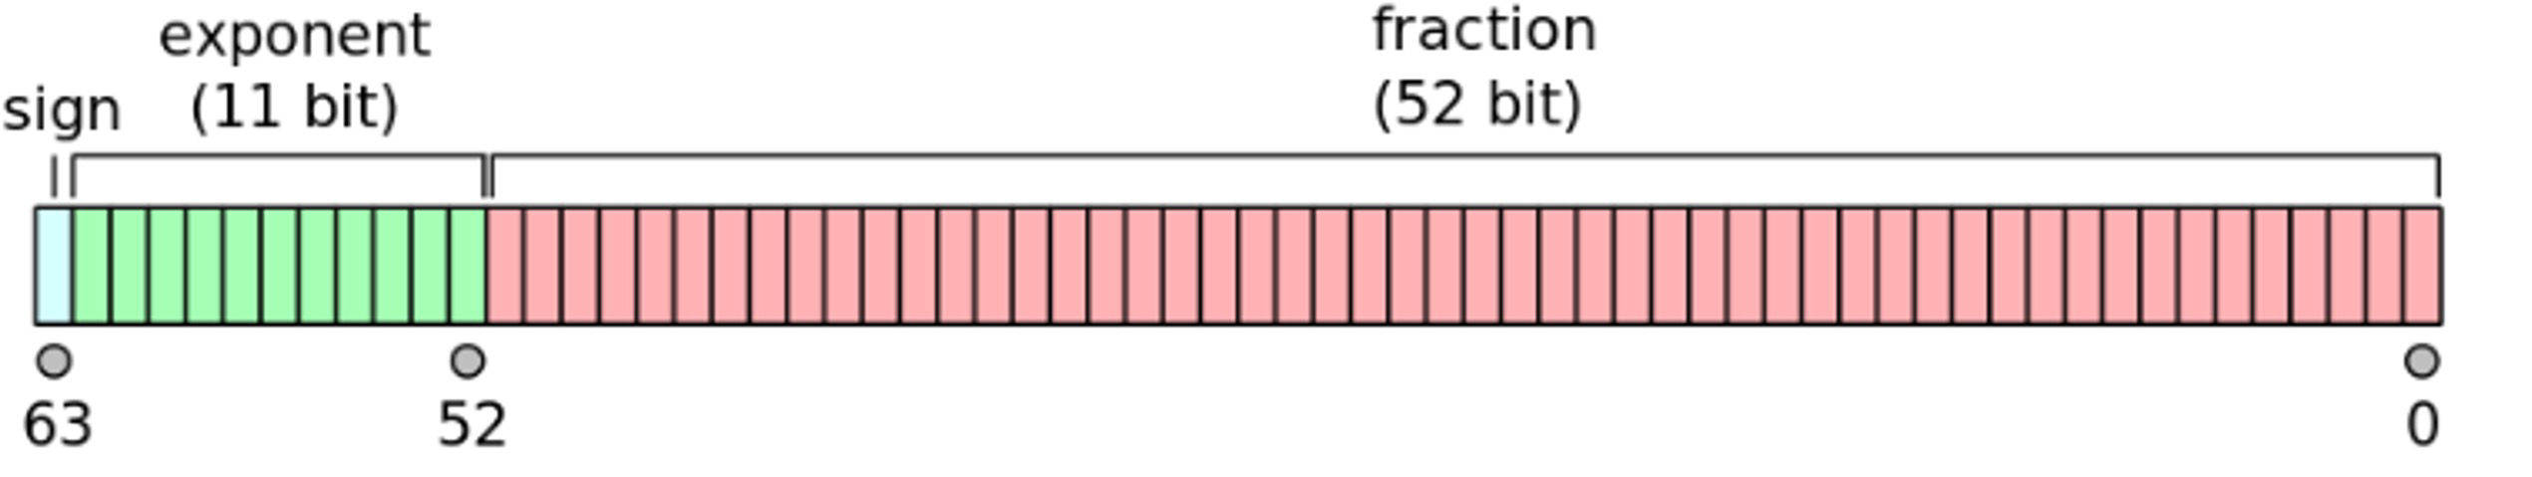
Introduction to R
RAM needed
CSV file with 1,500,000 rows and 120 columns, each cell being a number.
Double-precision floating-point format
2¹¹ = 2048

Slide 7
Introduction to R
R System
Download R from CRAN (Comprehensive R Archive Network)
http://cran.r-project.org
You are downloading the BASE package
the base package which is required to run R and contains the most fundamental functions.
You then download other packages that you may need
– more on this later

Slide 8
Introduction to R
R Packages
4000 packages on CRAN (Comprehensive R Archive Network)
– https://cran.r-project.org/

Slide 9
Introduction to R
R & RStudio Installation
Download and Install R
https://cran.r-project.org/
Download and Install RStudio
https://www.rstudio.com/
A step-by-step instruction for installing R and RStudio is available in Blackboard module area.

Slide 10
Introduction to RStudio
RStudio allows the user to run R in a more user friendly environment. It is open source (i.e. free) and available at
– http://www.rstudio.com/
Similar to the Matlab environment

Slide 11
Introduction to RStudio
The usual Rstudio screen has four windows:
1. Console.
2. Workspace and history.
3. Files, plots, packages and help.
4. The R script(s) and data view.

Slide 12
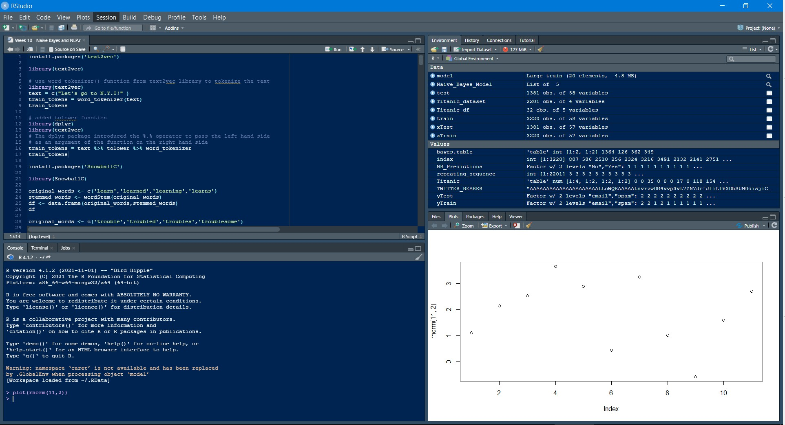
Introduction to R Studio

Slide 13
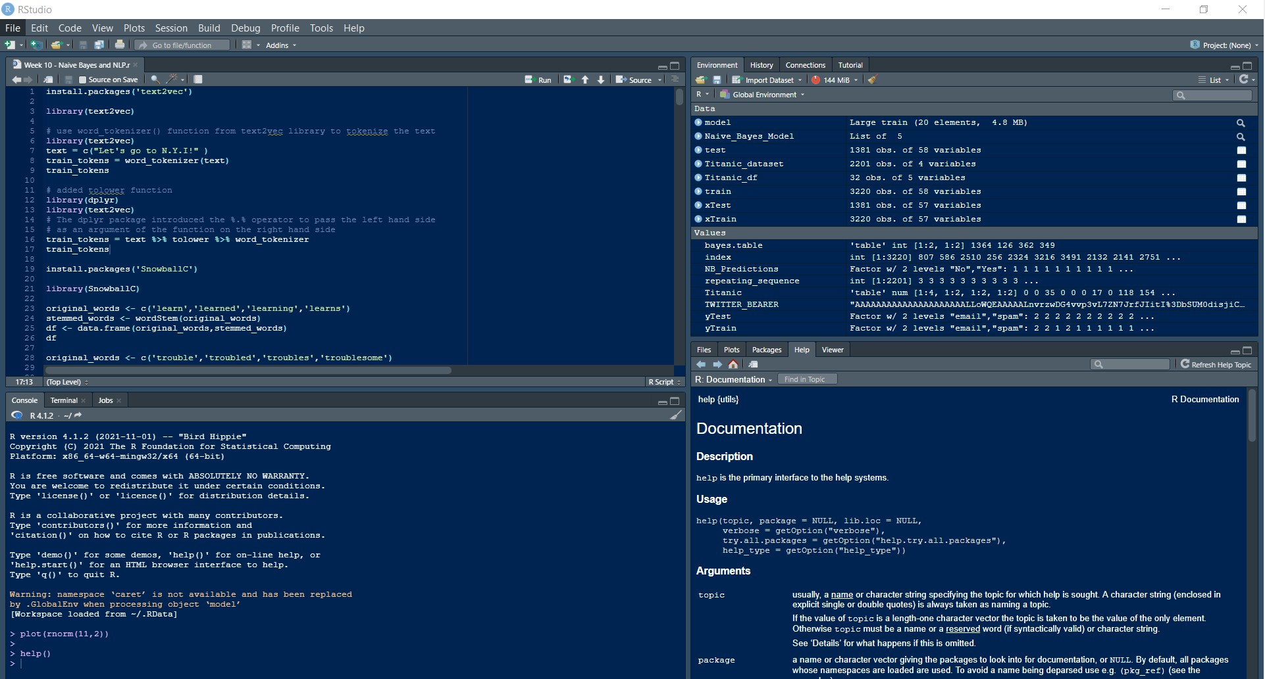
Introduction to R Studio
Help in R

Slide 14
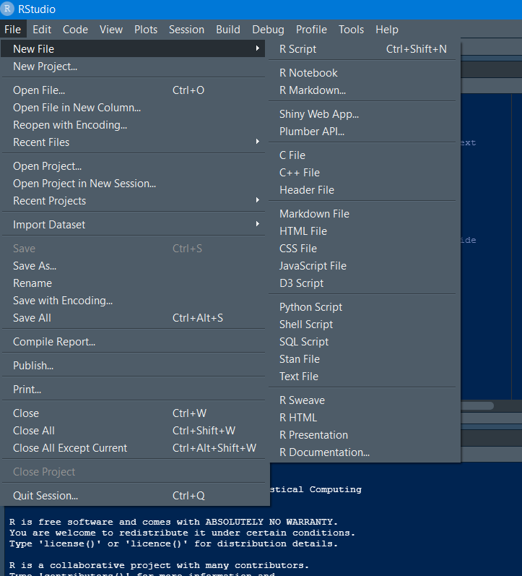
Introduction to R Studio
Create a R Script

Slide 15
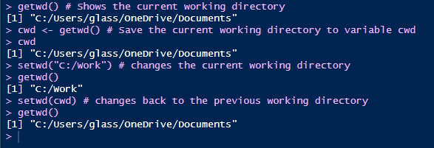
Introduction to R Studio
Working Directory
Shows the working directory (wd) getwd()
Changes the wd setwd(“C:/myfolder/data")
Saved workspace is in a file called .Rdata

Slide 16
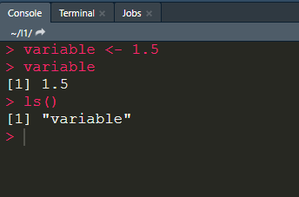
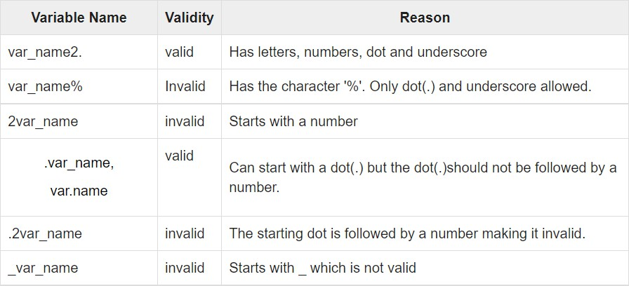
R Basics
Variables
Variable Assignment – using <- not =
Call variable
Finding variable – ls()
Validity of a variable name
https://www.tutorialspoint.com/r/r_variables.htm

Slide 17

Introduction to R Studio
Hello world example
Comment in R, use # ,
R is case sensitive (so msg and Msg are different variables)
Type the following into the R console:
msg <- “hello world”; print(msg);
msg;
#explicit printing #auto-printing occurs

Slide 18
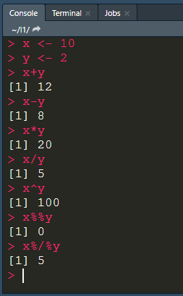
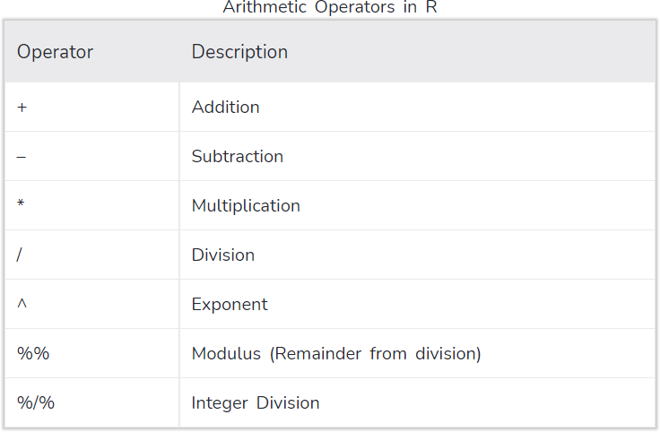
R Basics
Arithmetic
https://www.datamentor.io/r-programming/operator/

Slide 19
R Basics
R basic data types
5 basic atomic classes
numeric (real or decimal) (e.g., 2, 2.0, pi)
logical (e.g.’ TRUE, FALSE)
integer (e.g., 2L, as.integer(3))
complex (e.g., 1 + 0i, 1 + 4i)
character (e.g., "a", "swc")
Check the data type
class() or typeof()

Slide 20
R Basics
R basic data types
Numbers (double precision real numbers)
If you want an integer, you specify the L suffix
1 gives you a numeric object; 1L gives you an integer object
There is also the number Inf (infinity);
e.g. 1 / 0 = Inf
1 / Inf = 0
The value NaN (“not a number”);
e.g. 0 / 0 = NaN
can also be thought of as a missing value
NULL can be thought of as undefined

Slide 21
R Basics
R basic data structures
R’s basic data structures include:
Vectors
Matrices
Data Frames
Lists
Factors
…

Slide 22
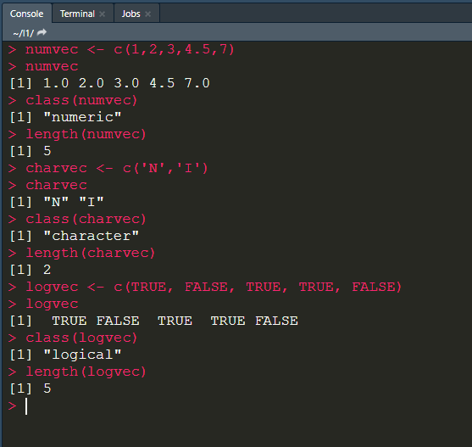
R Basics
Vector
A vector is a 1-dimensional array that can hold character, numeric, or logical data elements.
Create a vector by using c()
Check a vector’s type by using class() function
Check a vector’s length by using length() function

Slide 23
R Basics
Vector
x <- c(0.5, 0.6)
x <- c(TRUE, FALSE)
x <- c(T, F)
x <- c("a", "b", "c")
x <- c(1,2,3)
x <- c(1+0i, 2+4i)
## numeric
## logical ## logical ## character ## integer ## complex

Slide 24
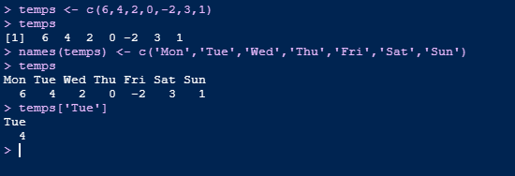
R Basics
Vector
Vector Names
names()
key value pairs

Slide 25
R Basics
Vector
Vector must have elements of the same type!
What will happen here? y <- c(1.7, "a”)
y <- c(TRUE, 2) y <- c("a", TRUE)
Implicit coercion occurs so that every element in the vector is of the same class

Slide 26
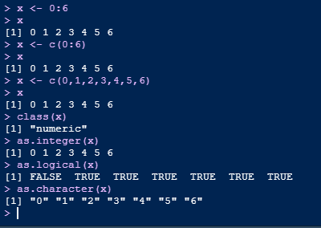
Explicit Coercion
Coercion from one class to another using the as.* functions:

Slide 27
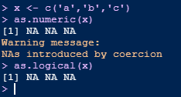
Nonsensical Coercion
Sometimes, R can’t figure out how to coerce an object and this can result in NAs being produced.
When nonsensical coercion takes place, you will usually get a warning from R.

Slide 28
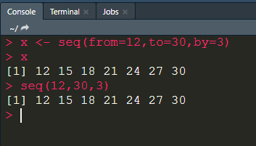
R Basics
Vector
Creating Vectors using seq() function
– Generate regular sequences.

Slide 29
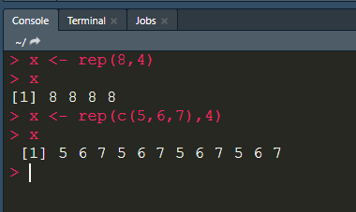
R Basics
Vector
Creating Vectors using repeat() function
– Generate repeat sequences.

Slide 30
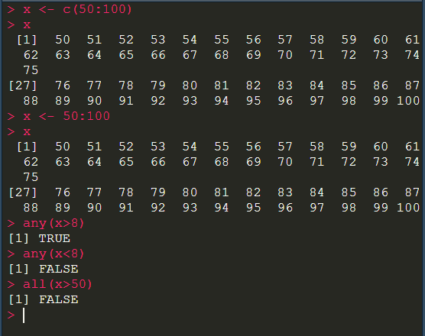
R Basics
Vector
Evaluating Vectors using any() and all()

Slide 31
R Basics
Vector operations
Basic arithmetic with vectors +/-,*, /
Built in functions for vectors, check for sum, average, standard deviation, variance, maximum element, minimum element, product of elements:
sum(), mean(), sd(), max, min(), prod(),

Slide 32
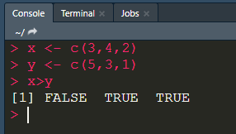
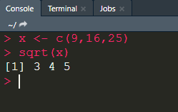
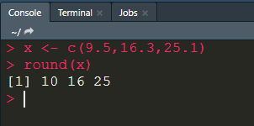
R Basics
Vectorisation and Vectorised Functions
>
sqrt()
round()

Slide 33
R Basics
Recycling of Vector Elements
R automatically repeats or recycles vectors when necessary
x <- c(3,4,2)
x+2
5 6 4 # element wise addition
c(3,4,2) + c(2,2,2)

Slide 34
R Basics
Recycling of Vector Elements
c(1,2,4) + c(6,0,9,20,22,11)
Becomes
c(1,2,4,1,2,4) + c(6,0,9,20,22,11)
c(2) + c(6,0,9,20,22)
2 + c(6,0,9,20,22)
Becomes
c(2,2,2,2,2) + c(6,0,9,20,22)

Slide 35
R Basics
3 Key principles
Recycling
Automatic lengthening/repetition of vectors
Filtering
Subsetting / creating sub vectors
Vectorisation
Where functions are applied to element-wise to vectors

Slide 36
R Basics
Vector Indexing and Slicing
Indexing based on position of the element – vector[index]
Slicing by using a colon(:)
– vector[start_index:stop_index]

Slide 37
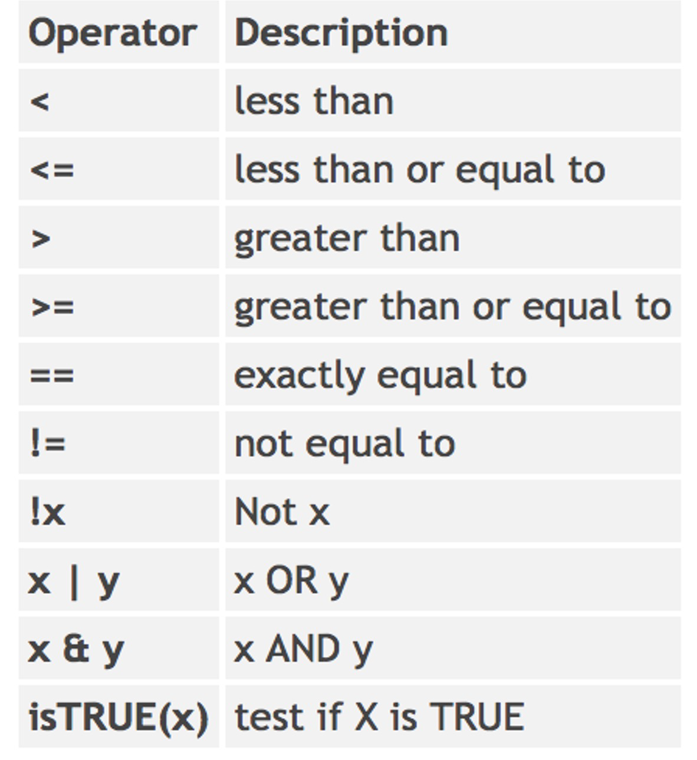
R Basics
Vector Indexing and Slicing
Comparison Operators and Selection
http://www.statmethods.net/management/operators.html

Slide 38
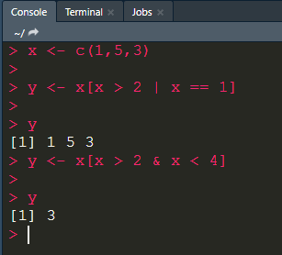
R Basics
Vector Indexing and Slicing
Sub-vectors (subsetting/filtering) x <- c(1,5,3)
y <- x[x > 2 | x == 1] y <- x[x > 2 & x < 4]

Slide 39
R Basics
Vector Indexing and Slicing
Recoding example - ? x <- c(5,2,3,8)
x[x > 4] <- 0

Slide 40
R Basics
Vector Indexing and Slicing
Using the subset() function
x <- c(1:5) #same as c(1,2,3,4,5) y <- subset(x, x > 2)
3 4 5
x[x > 2]
Advantage of subset() – removes NA values

Slide 41
R Basics
Vector Indexing and Slicing
Using the which() function x <- c(8, 1, 5, 2)
which(x > 2)
1 3
which.max(x) 1

Slide 42
R Basics
Simulating Data in R
?rnorm
x <- rnorm(10)
x <- rnorm(10, 20, 2) summary(x)

Slide 43
R Basics
Setting the seed
set.seed(1) rnorm(5)
rnorm(5)
set.seed(1) rnorm(5)

Slide 44
R Basics
Bootstrapping: Random Sampling
set.seed(2) sample(c(1:10), 4)
3 4 5 7
set.seed(2)
sample(c(1:10), 4, replace = TRUE) 5 6 6 8
set.seed(2)
sample(c(1:10), 10, replace = TRUE) 5 6 6 8 1 1 9 2 1 3

